Slide 1
Object Recognition and Image Enhancement for Night Vision Surveillance
Aayush Kafle
Aashish Bhandari
Pranjal Dhakal
Prateek Raj Joshi

Slide 2
Steps:
Start
Initiation
Client Operation
Network Operation
Preprocessing
Classification
User Alerting

Slide 3
Initiation (Boot)
RPI’s hardware interfacing is checked (NoIR camera).
RPI and server and networking devices boot.
RPI and Server is connected to a common network via wireless interface.

Slide 4
Client operation
GUI for image transmission is launched.
Command for image capture is provided.
Image is captured using NoIR camera.
Image resolution is reduced to 640x480.

Slide 5
Network operation
Both client and server are connected to common network.
Server and client are assigned static IP.
Transmission takes place securely via SSH (Secure Shell) protocol.
The services used are SCP (Secure Copy) and SFTP (Secure File Transfer Protocol).

Slide 6
Preprocessing / Enhancement
The received image is then subjected to preprocessing.
The main object is isolated from the background.
Image enhancement techniques like contrast stretching and histogram equalization to enhance clarity of the image.

Slide 7

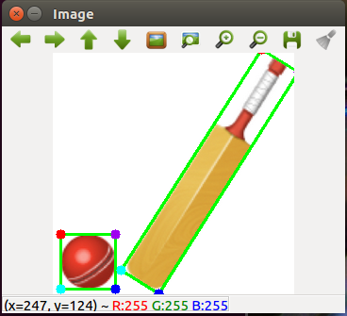
Object separation

Slide 8
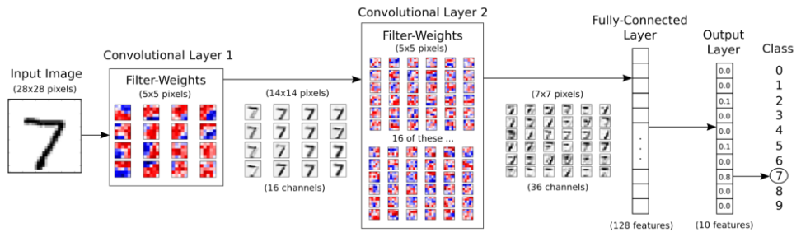
MNIST CNN Model
Basic CNN architecture.
97% test accuracy in 3000 iterations.
Trained under 5 minutes.
Moderately resource intensive.

Slide 9
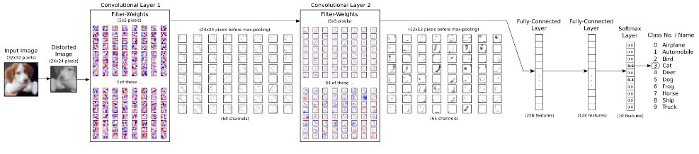
CIFAR-10 CNN Model
Built over the MNIST CNN Model.
About an hour for 1000 iterations.
Extremely resource intensive.

Slide 10
Classification
The Google inception model is tweaked to fit in our classification requirements.
It is used for the purpose of classifying common objects.
The classifier predicts the most likely class out of many trained objects classes with certain confidence level.

Slide 11
User Alerting
Currently we have only managed to display the predicted result in server terminal application.

